Slide 1
WP4 – Knowledge base Design and Implementation
Dr. Erhan Mengusoglu
MANTIS

Slide 2
WP4 Knowledge Base Design and Implementation
Design and implement the ModelWriter’s federated Knowledge Base itself, hosting multiple formalisms.
Design and implement its bi-directional text-model synchronization mechanism.
Design and implement its API.
Design and implement a set of specialised modules (plug-ins) that exploit the Knowledge Base in ways that make the tasks of Technical Authors much more productive, e.g. consistency checks.
Design and implement the collaborative functions linking and hierarchically organizing multiple ModelWriter KBs used by different Technical Authors on different sites.

Slide 3
WP4 Knowledge Base Design and Implementation
Plug-in #1 – This provides consistency and completeness checks within the same software lifecycle document, allowing automatic quality review of the content (meaning).
Plug-in #2 – This provides consistency and completeness checks between related set of documents.
Plug-in #3 – This provides semantic comparison between two versions of the same software lifecycle document (i.e. what conceptual changes have happened).

Slide 4
WP4 Knowledge Base Design and Implementation
T4.1 - Design of the Knowledge Base (MANTIS + OBEO + KUL2 + UNIT + KOCSISTEM)
T4.2 - API of the Knowledge Base (KOCSISTEM + KUL2 + + OBEO + UNIT + HISBIM)
T4.3 - Implementation of the Knowledge Base (KUL2 + MANTIS + HISBIM)
T4.4 – Plug-in #1: ModelWriter-assisted requirements review (KUL2 + MANTIS)
T4.5 – Knowledge Base serialization and reuse plug-in (MANTIS)
T4.6 – Plug-in #3: ModelWriter-assisted semantic comparison of 2 documents (OBEO + MANTIS + HISBIM)
T4.7 – Plug-in #2: ModelWriter-assisted compliance review (MANTIS + UNIT + AIRBUS +SOGETI)
T4.8 – Internal bi-directional synchronization mechanism (OBEO + UNIT)
T4.9 – External synchronization mechanism for collaborating ModelWriters (HISBIM)

Slide 5
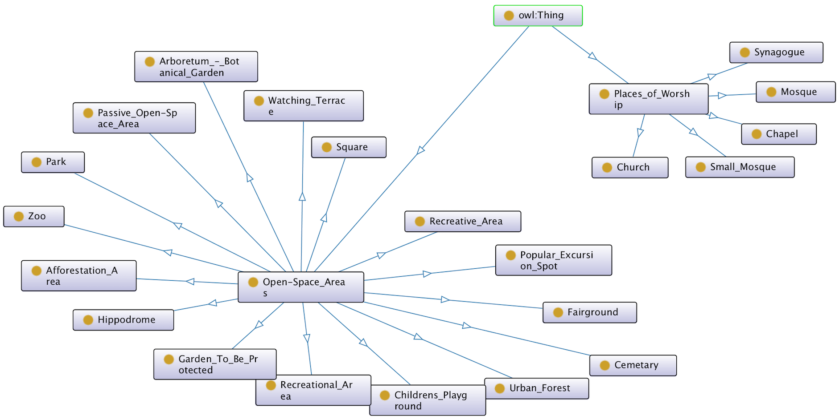
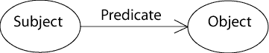
WP4 - T4.1 – Design of the Knowledge Base
Semantic Web
RDF Expression

Slide 6
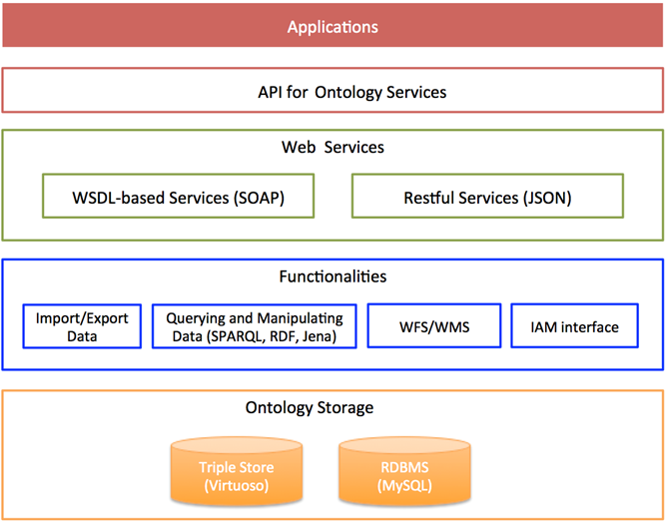
Ontology as a service

Slide 7
Implemented Services
executeQuery (ontology, queryString): Executes queryString (a SPARQL query) against ontology and returns triples.
exportFromOntology (ontology, outputFile, type): Exports the content of ontology into outFile of type type. Type is either CSV or RDF.
importIntoOntology (ontology, inputFile, type): Imports the content of inputFile of type type into ontology. Type is either CSV or RDF.
insertTriple (ontology, triple): Inserts triple into ontology.
removeTriple (ontology, triple): Deletes triple from ontology.
updateTriple (ontology, tripleOld, tripleNew): Changes the value of tripleOld as tripleNew in ontology.

